Slide 1
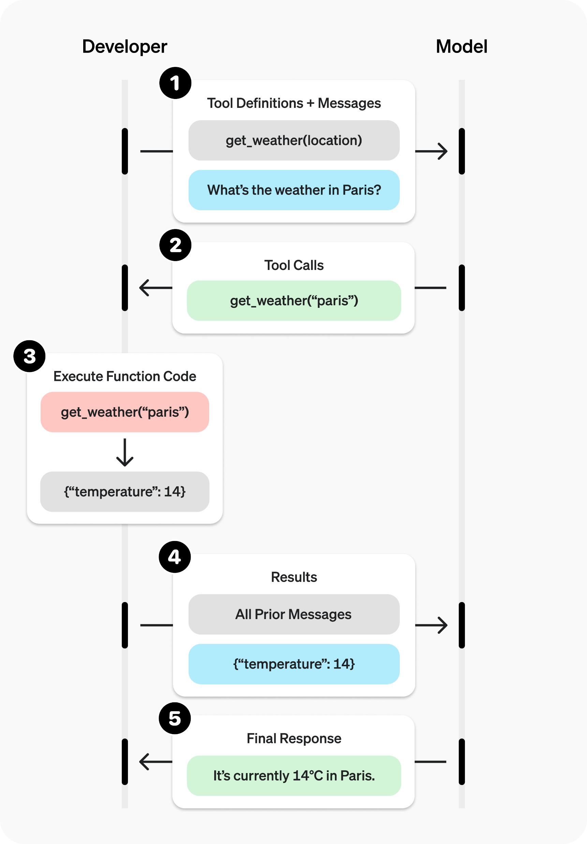
Tool Use & Function Calling: The AI's Hands
LLMs are naturally "stuck" in their training data; Tool Use allows them to interact with the real world in real-time.
Function Calling: The model detects when it needs a tool and generates structured data (like JSON) to call a function (e.g., a Calculator or a Database).
This allows the AI to perform specific actions like searching the web, executing code, or checking a user's calendar.

Slide 2
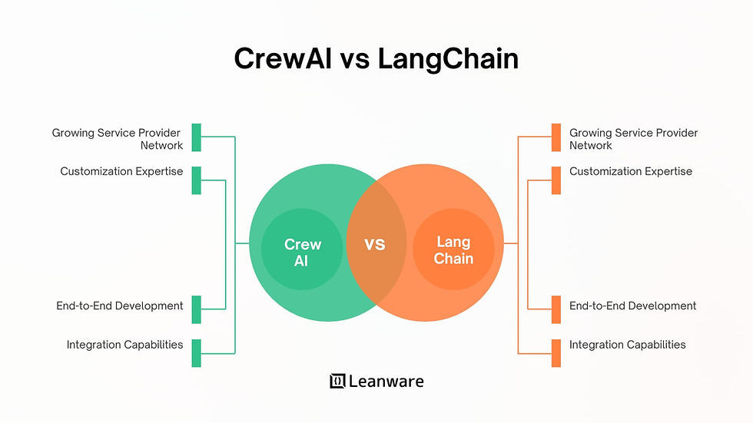
Multi-Agent Systems: CrewAI and LangChain
Instead of asking one AI to do everything, we assign specific Roles (e.g., Researcher, Writer, Quality Analyst).
Frameworks like LangChain and CrewAI manage the "handoffs" and communication between these agents.
This collaborative approach reduces errors and allows for complex, multi-stage workflows that mimic a human team.

Slide 3
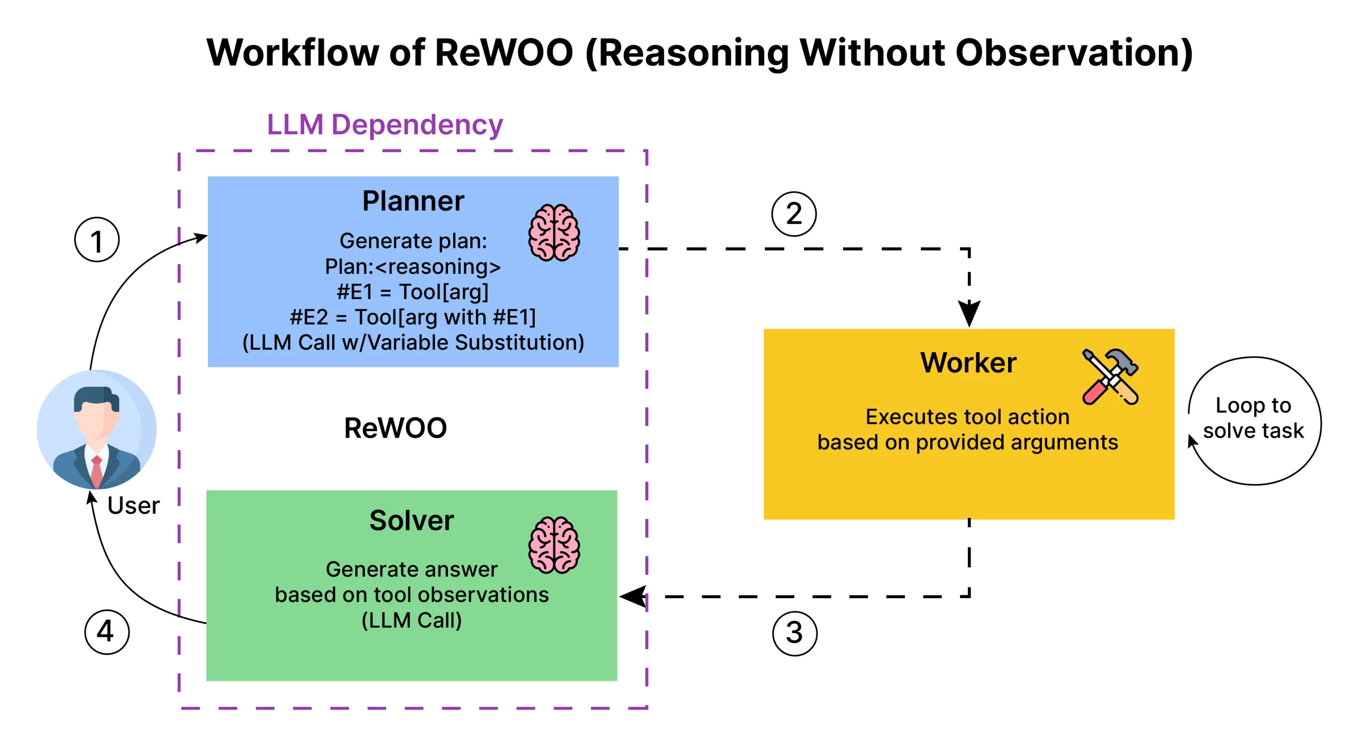
Planning & Memory: Achieving Long-Term Goals
Planning: The agent breaks a high-level goal into smaller, actionable tasks (Task Decomposition).
ReAct Pattern: The model follows a "Reason + Act" loop—it thinks about what to do, takes an action, observes the result, and iterates.
Memory: Agents use short-term memory (context window) and long-term memory (Vector DBs) to remember what they have already accomplished.

